Slide 1

Introduction to Artificial Intelligence
Dr. Mukti Padhya
Assistant Professor, NFSU

Slide 2
CTMTCS SII P1 : Artificial Intelligence
Subject Details
Teaching Scheme
Theory Credits : 3
Practical Credits : 1
Evaluation Scheme
Internal Exams
TA1/ TA2 (25 Marks Each)
MId Sem Exam : 50 Marks
End Sem Exam : 100 Marks
Practical End Sem Exam : 100 Marks

Slide 3
Syllabus
Unit – I Introduction to Maths for ML and Python
Unit – II Machine Learning
Unit – III Neural Network
Unit – IV Computer Vision and Natural Language Processing
Unit - V ML/DL for Cyber Security

Slide 4
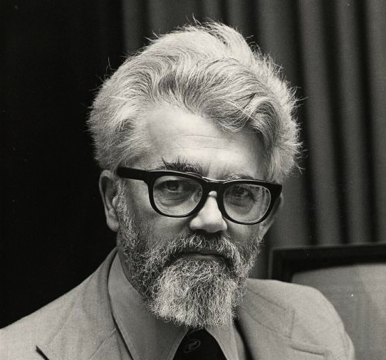
INTRODUCTION
AI is the science and engineering of making intelligent machines, especially intelligent computer programs (1956).
John McCarthy
(the father of Artificial Intelligence)
AI is a branch of computer science dealing with the simulation of intelligent behavior in computers.
AI is the study of how to make computers do things which, at the moment, people do better.
AI is, the study and design of intelligent agents where an intelligent agent is a system that perceives its environment and takes actions.

Slide 5

What is AI?
“Artificial Intelligence is a technique that allows machines to act like humans by replicating their behavior and nature.”

Slide 6
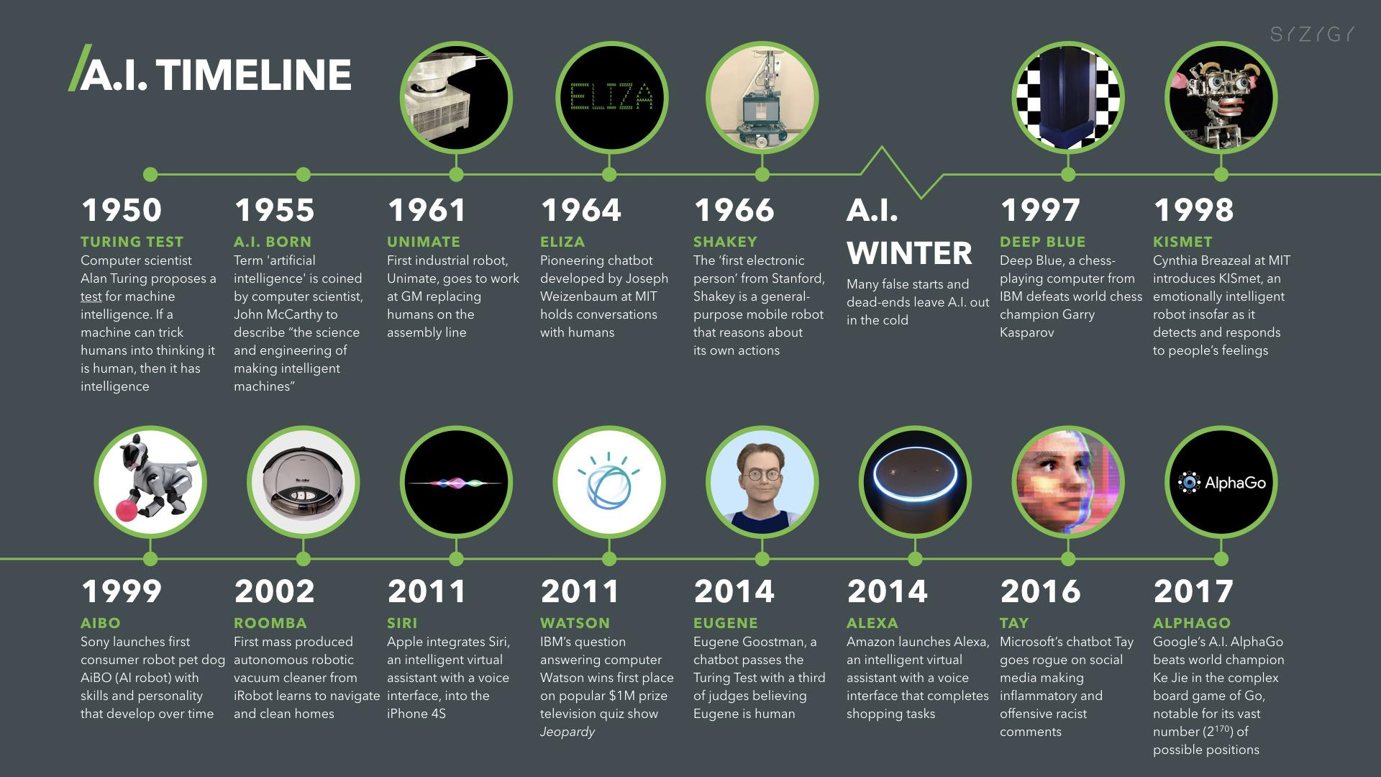
History of AI

Slide 7
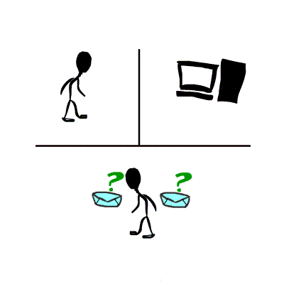
Turing Test
Acting Humanly: The Turing Test proposed by Alan Turing (1950)
A Turing Test is a method of inquiry for determining whether or not a computer is capable of thinking like a human being.
The interrogator job is to try and figure out which one is human and which one is computer by asking questions to both of them.
The computer would try to remain indistinguishable from human as much as possible

Slide 8
Technique that enables machines to mimic human behavior
AI
Machine Learning
Subset of AI which uses statistical methods to enable machine to learn and improve with time
Data Science
Deep Learning
Subset of ML that includes algorithms and enables system to train itself

Slide 9
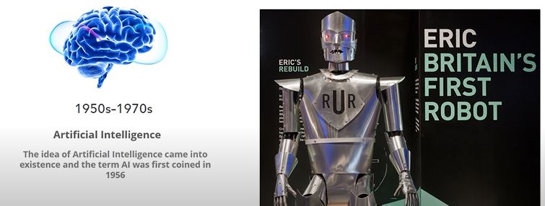
Why AI Winter?
The data we had was not enough to predict the accurate result.

Slide 10
Why AI Winter?
Big Data - accumulated volume of big data was increased from 4.4 zettabytes to roughly 44 zettabytes or 44 trillion GBs of data
Advanced algorithms
High end computing power
Large storage

Slide 11
Application Domains of AI

Slide 12
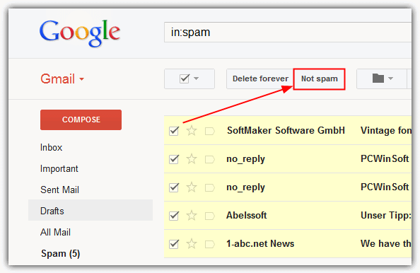
Machine Learning: Spam Filter in Gmail

Slide 13
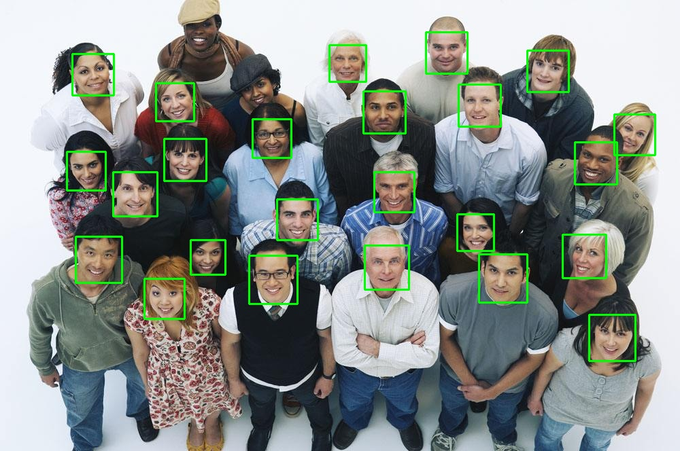
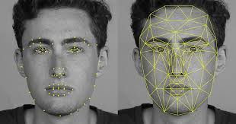
Computer Vision: Face Detection

Slide 14
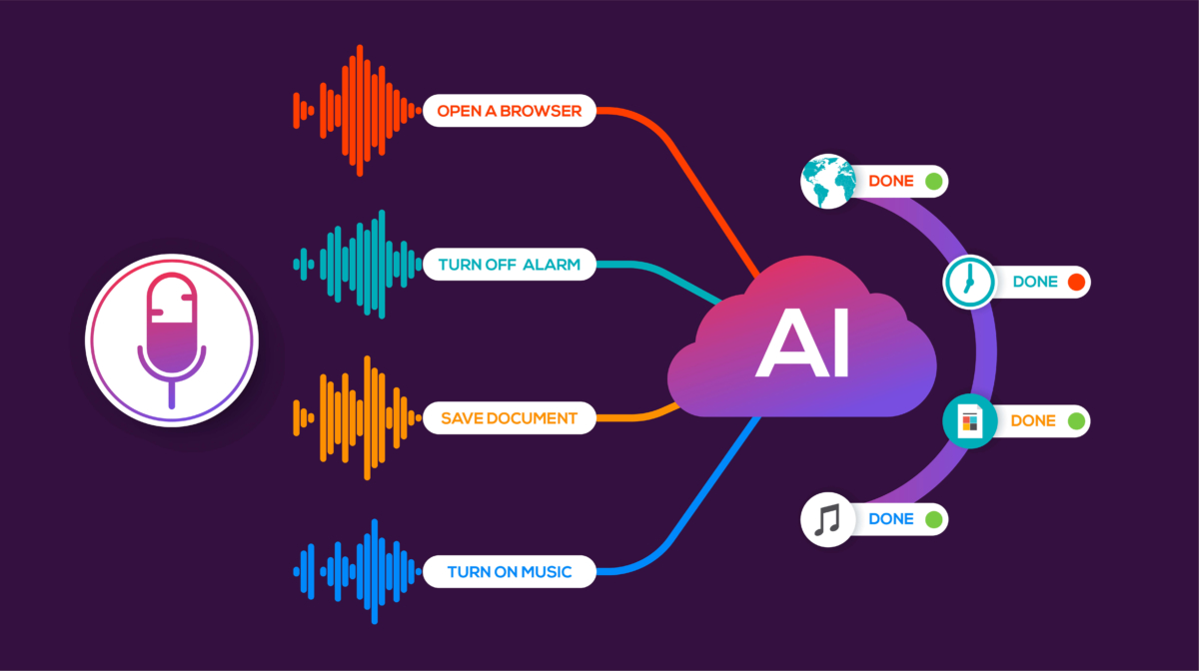
Speech Recognition: Voice Technology In Virtual Agents

Slide 15
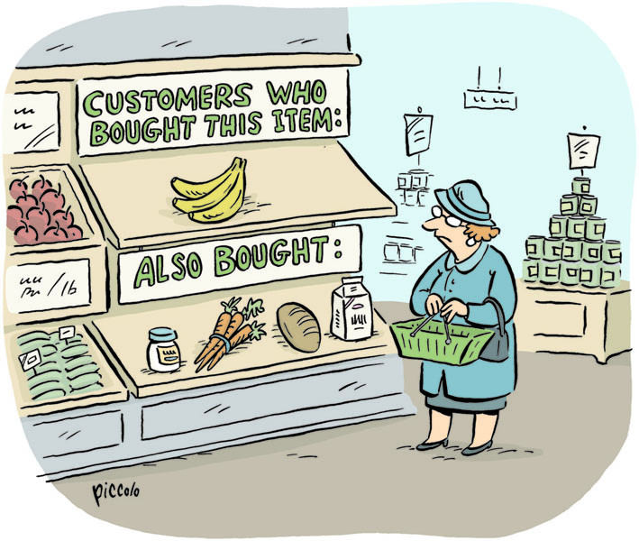
Data Mining: Market Basket Analysis

Slide 16

Expert Systems: Reinforcement Learning

Slide 17
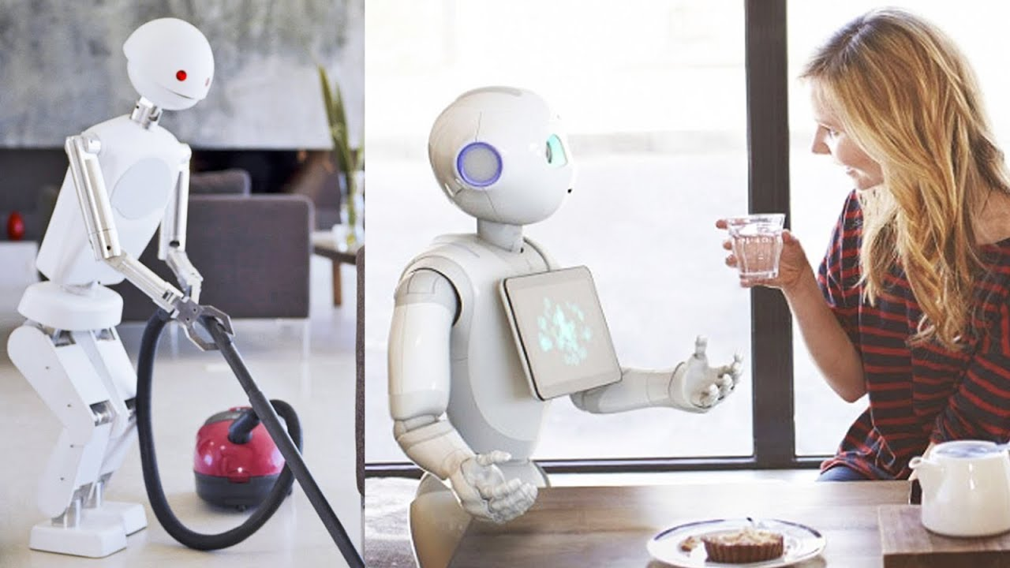
Robotics: Home Automation System

Slide 18

Optimization : Shortest Path

Slide 19
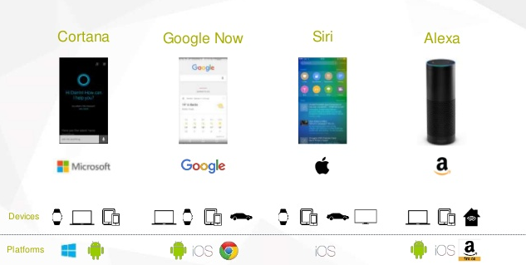
Virtual Agents : Chatbots

Slide 20
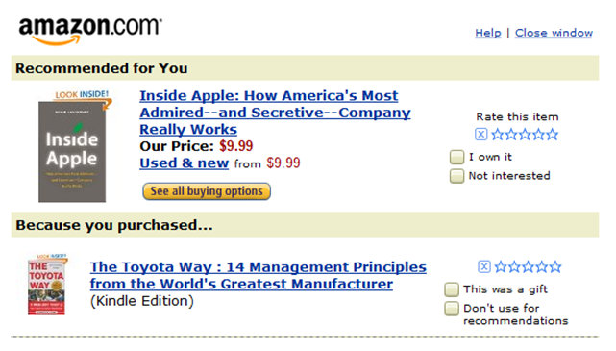
Supervised Learning : Online Shopping
Dr. Madhavi Dave

Slide 21
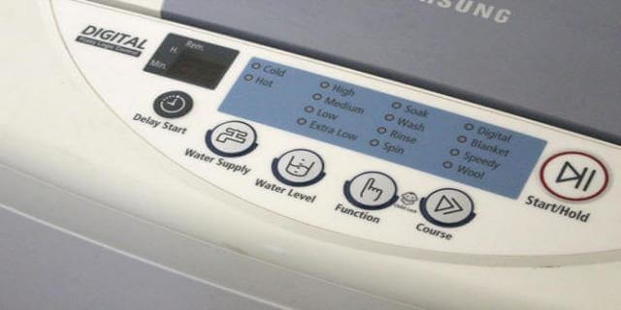
Fuzzy System : Automated Controlled Machine

Slide 22
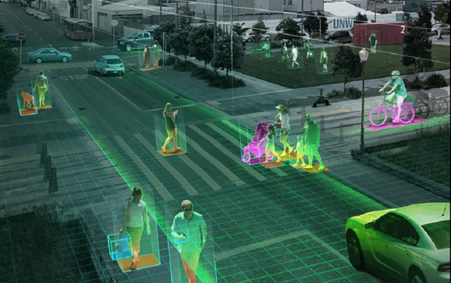
Security: NVIDIA Metropolis

Slide 23
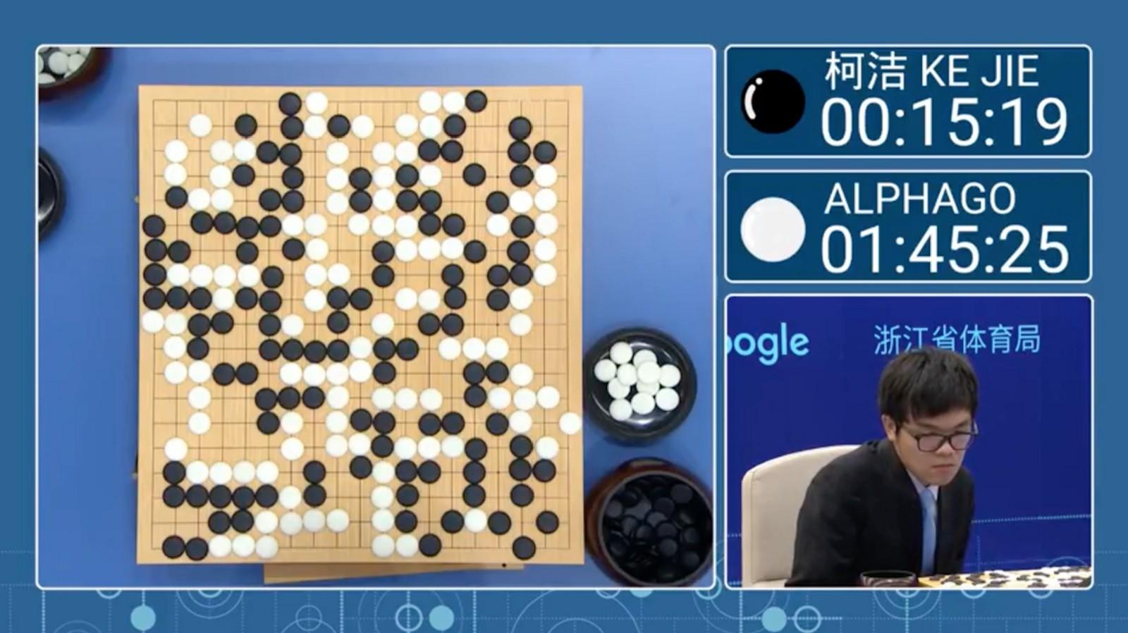
Game Playing

Slide 24
Virtual Agents : Chatbots
Artificial Intelligence
Dr. Madhavi Dave

Slide 25
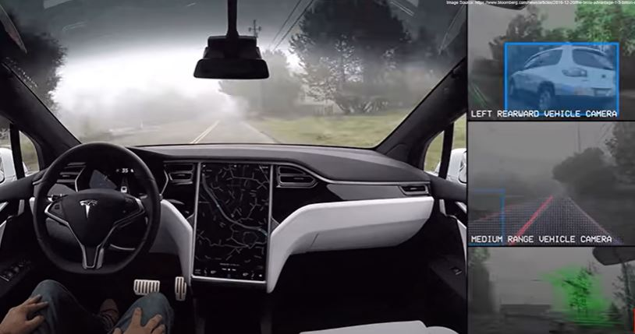
Tesla’s Self-Driving Car

Slide 26
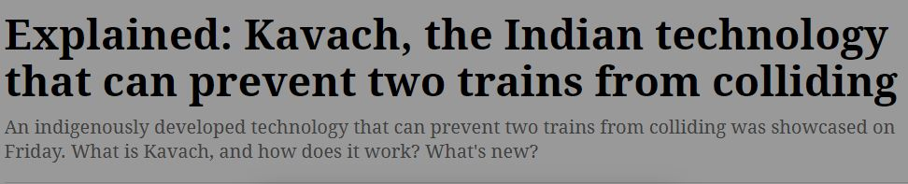
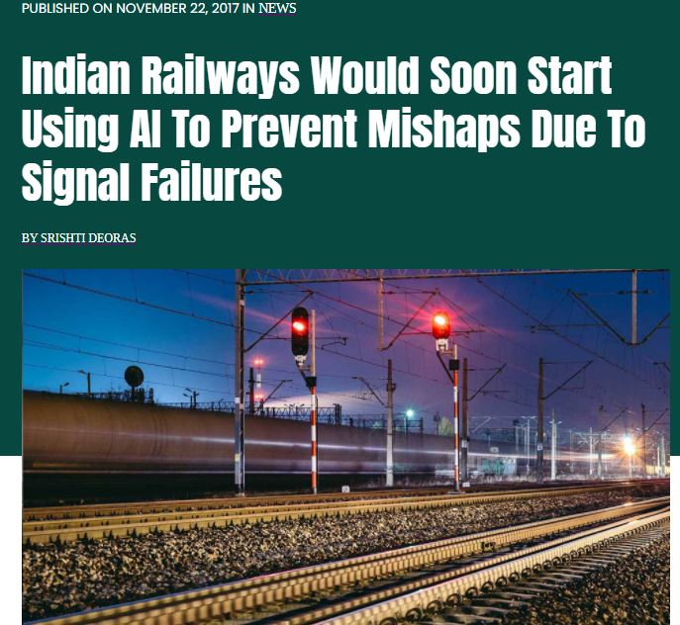

AI : In NEWS

Slide 27
Techniques of AI

Slide 28
Abstraction
Use of Knowledge
Search
Provides a way of separating important features and variations
Provides a way of solving complex problems by exploiting the structure of the objects
Provides a way of solving problems
Provides a framework

Slide 29
Why ML was Introduced?
How to efficiently train large complex models?
How to train more robust version of the AI systems?
How to design operational models of the brain?

Slide 30
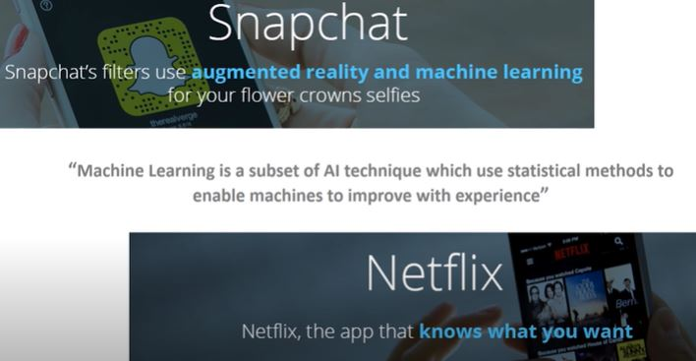
What is ML?

Slide 31
What is ML?
Machine learning is a subset, an application of Artificial Intelligence (AI) that offers the ability to the system to learn and improve from experience without being programmed to that level.
Machine Learning uses data to train and find accurate results.
Machine learning focuses on the development of a computer program that accesses the data and uses it to learn from itself.
Example
Google uses it to filter spam, malware, and attempted phishing emails out of your inbox.
Your bank and credit card use it to generate warnings about suspicious transactions on your accounts.

Slide 32
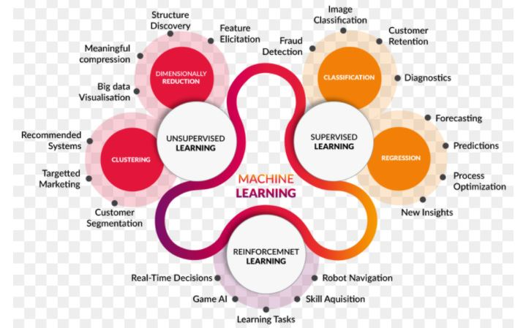
What is ML?

Slide 33
What is ML?
Supervised learning & semi-supervised learning
Supervised learning is a subset of machine learning that requires the most ongoing human participation — hence the name ‘supervised’. The computer is fed training data and a model explicitly designed to ‘teach’ it how to respond to the data.
Once the model is in place, more data can be fed into the computer to see how well it responds — and the programmer/data scientist can confirm accurate predictions, or can issue corrections for any incorrect responses.
In semi-supervised learning, the computer is fed a mixture of correctly labeled data and unlabeled data, and searches for patterns on its own. The labeled data serves as ‘guidance’ from the programmer, but they do not issue ongoing corrections.
Unsupervised learning
Unsupervised learning takes this a step further by using unlabeled data. The computer is given the freedom to find patterns and associations as it sees fit, often generating results that might have been unapparent to a human data analyst.
A common use for unsupervised learning is ‘clustering’, where the computer organizes the data into common themes and layers it identifies.

Slide 34
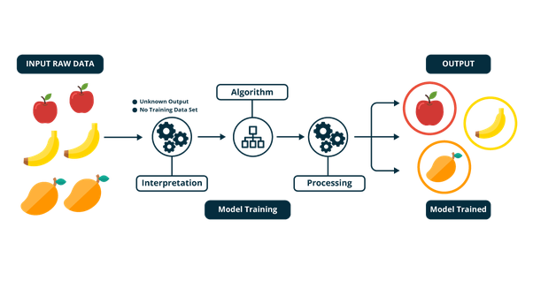
How ML works?

Slide 35
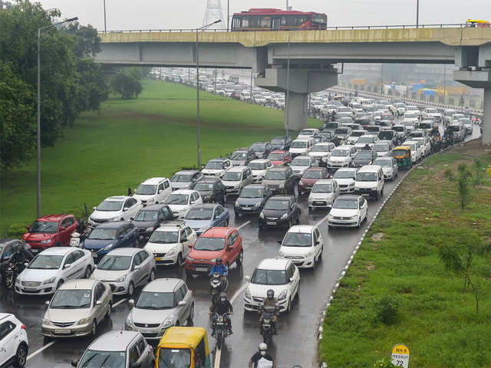
Example : ML Traffic Prediction

Slide 36
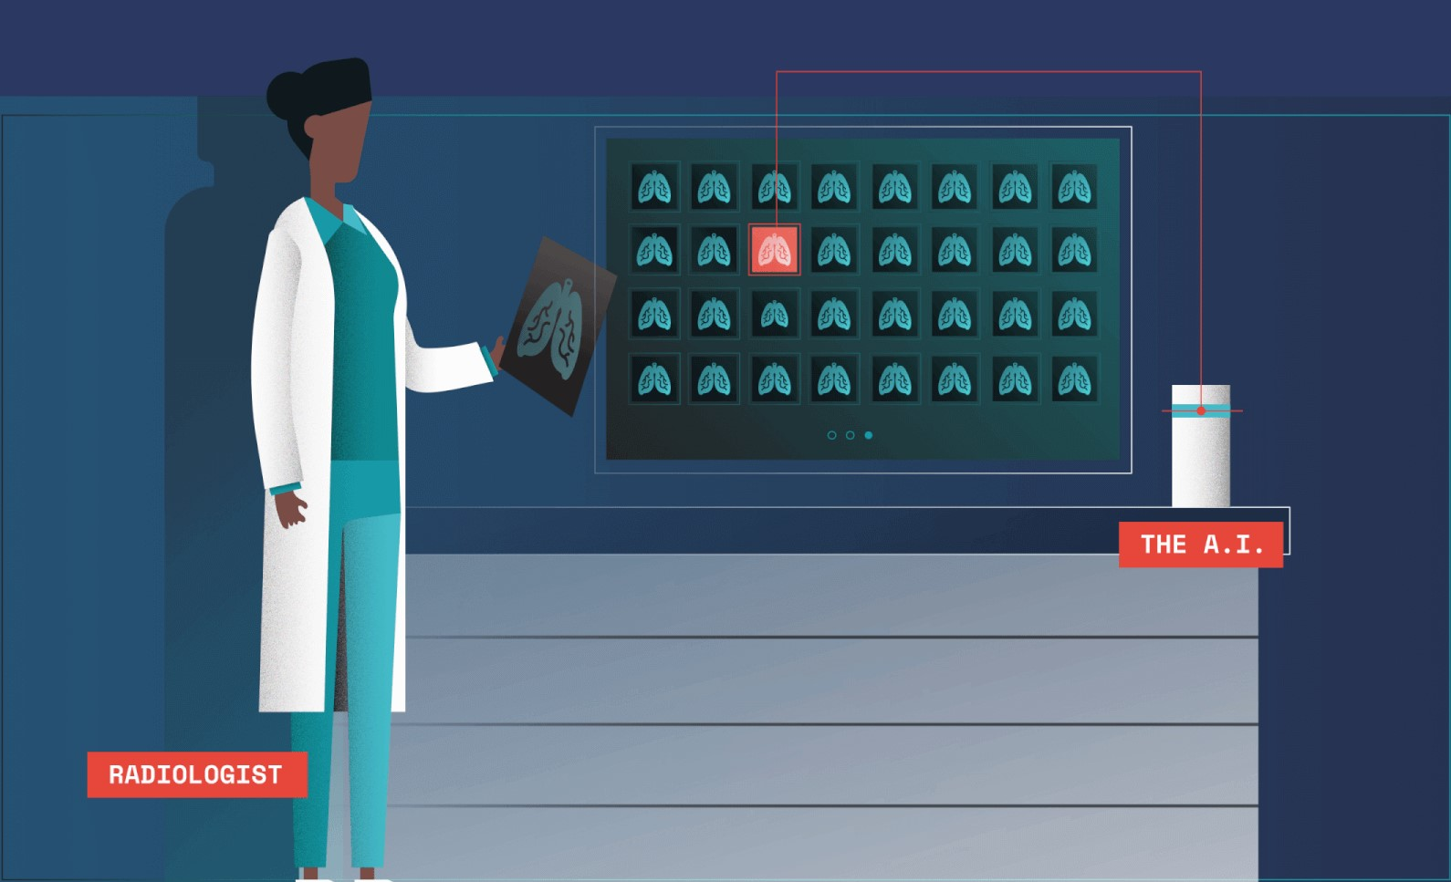
Example : ML Illness Prediction

Slide 37

Example : ML Smart Cart : E - Commerce

Slide 38
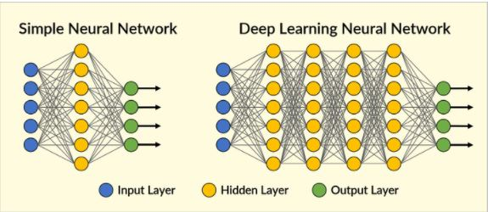
Deep Learning :DL
“DL is a particular kind of machine learning that is inspired by the functionality of our brain cells called neurons which led to the concept of artificial neural network”

Slide 39
Why Deep Learning?
Machine learning is about computers being able to perform tasks without being explicitly programmed… but the computers still think and act like machines.
Their ability to perform some complex tasks — gathering data from an image or video, for example — still falls far short of what humans are capable of.
Deep learning models introduce an extremely sophisticated approach to machine learning and are set to tackle these challenges because they've been specifically modeled after the human brain.
Complex, multi-layered “deep neural networks” are built to allow data to be passed between nodes (like neurons) in highly connected ways. The result is a non-linear transformation of the data that is increasingly abstract.

Slide 40
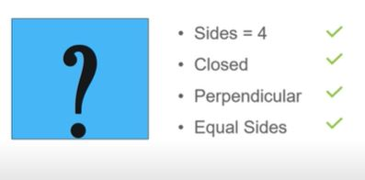
Example : DL Pattern Recognition

Slide 41
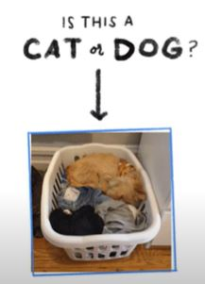
Example : DL Object Recognition

Slide 42
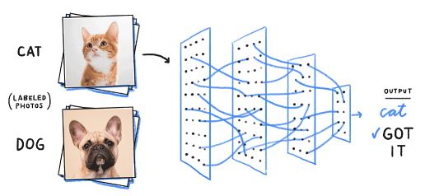
Example : DL Object Recognition

Slide 43
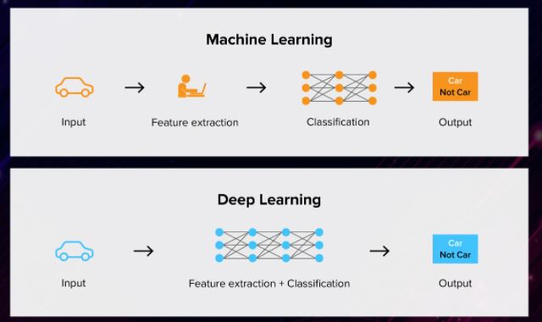
Ml vs DL Deep Learning IS Machine Learning

Slide 44
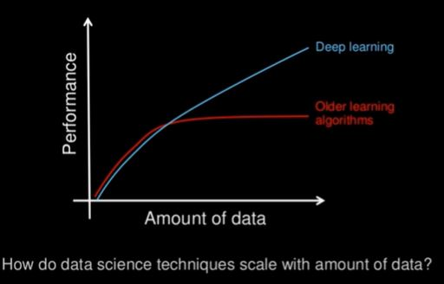
Ml vs DL Data Dependency

Slide 45

Ml vs DL Hardware Dependency

Slide 46
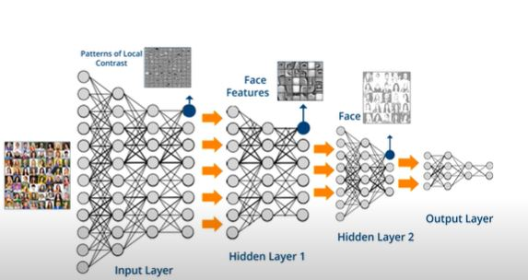
Ml vs DL Problem Solving Approach

Slide 47
Ml vs DL Execution Time?

Slide 48
Ml vs DL
Ml uses algorithms to parse data, learn from that data, and make informed decisions based on what it has learned
DL structures algorithms in layers to create an artificial “neural network” that can learn and make intelligent decisions on its own

Slide 49
Ml vs DL
Human Intervention
Machine learning requires more ongoing human intervention to get results. Deep learning is more complex to set up but requires minimal intervention thereafter.
Hardware
Machine learning programs tend to be less complex than deep learning algorithms and can often run on conventional computers, but deep learning systems require far more powerful hardware and resources. This demand for power has driven has meant increased use of graphical processing units.

Slide 50
Ml vs DL
Time
Machine learning systems can be set up and operate quickly but may be limited in the power of their results. Deep learning systems take more time to set up but can generate results instantaneously
Approach
Machine learning tends to require structured data and uses traditional algorithms like linear regression. Deep learning employs neural networks and is built to accommodate large volumes of unstructured data.
Applications
Machine learning is already in use in your email inbox, bank, and doctor’s office. Deep learning technology enables more complex and autonomous programs, like self-driving cars or robots that perform advanced surgery.

Slide 51
Python for Machine Learning

Slide 52
Unit I : Python
Basic Commands and Functions of Python
Python Scripting
numPy
It is a library for the Python programming language, adding support for large, multi-dimensional arrays and matrices, along with a large collection of high-level mathematical functions to operate on these arrays.
Pandas
It is a software library written for the Python programming language for data manipulation and analysis. In particular, it offers data structures and operations for manipulating numerical tables and time series.
Matplotlib
Matplotlib is a plotting library for the Python programming language and its numerical mathematics extension NumPy. It provides an object-oriented API for embedding plots into applications

Slide 53
What is Python?
Most popular language in the world!
Easier to understand and code in than C or C++.
It is an interpreted language.
Program executes line-by-line. No compilation.
It is a type less language.
No need to declare variables like int x in C.
It is an indented language.
Indentation is compulsory, otherwise your program will not run!

Slide 54
What is Python?
Contains libraries and support for almost everything.
It is called a scripted language.
Runs one thing at a time.
It is an object oriented language.
Shall learn more about this later.
It’s something like Java.
No pointers in Python. All data allocated dynamically.

Slide 55
Comparing C with Python3
Let’s compare the two hello world programs written in C and Python3.
#include <stdio.h>
int main()
{
printf(“Hello World!”);
return 0;
}
print(“Hello World!”)
C
Python3

Slide 56
Comparing C with Python3
Let’s compare the two hello world programs written in C and Python3.
#include <stdio.h>
int main()
{
int x= 2;
printf(“%d”, x);
return 0;
}
x= 2
x
C
Python3

Slide 57
Seting up The Environment
Assignments shall be given throughout the lab course. Practise coding well.
You can either use Google Colab : https://colab.research.google.com/
OR
Install Python3 in your system.
First, go to python website: www.python.org
Click on ‘Downloads’ in the website and download Python3
OR
Install Anaconda -Jupyter

Slide 58
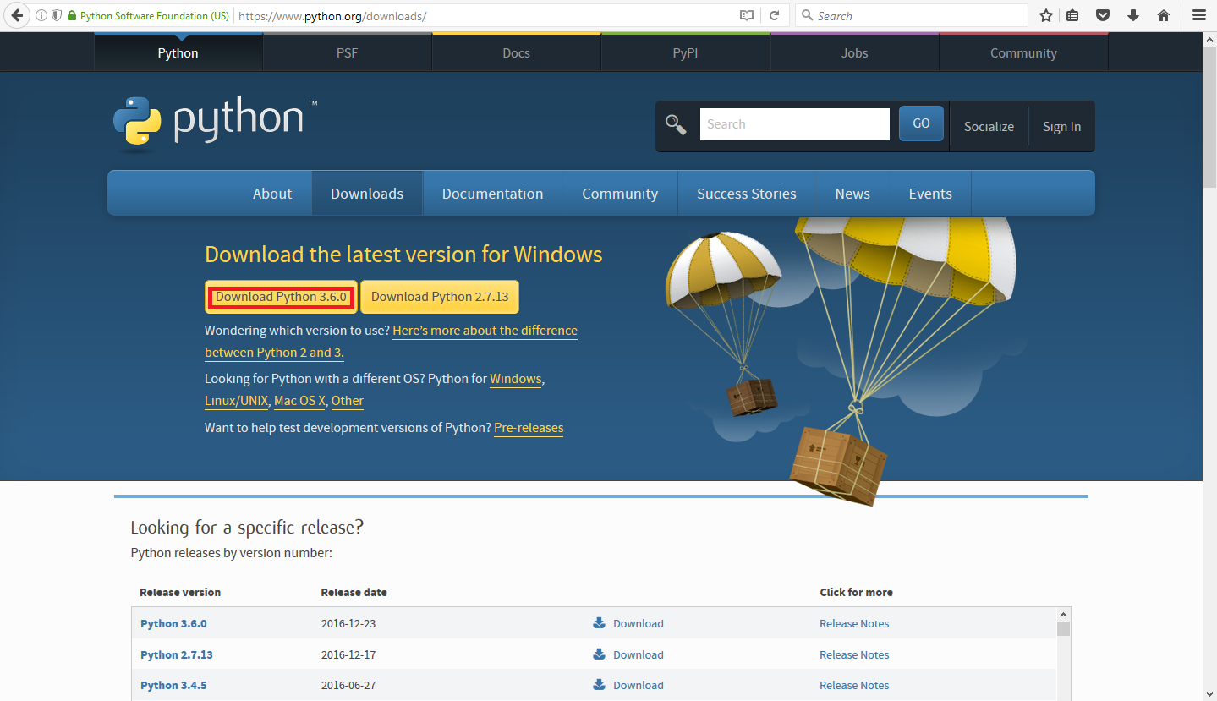
Installing Python3 on your Windows System

Slide 59
Installing Python3 on your Windows System
After the download is complete, run the exe file.
Once done, launch the program IDLE Python from Start Menu.
Start coding like you would do here in the lab!

Slide 60
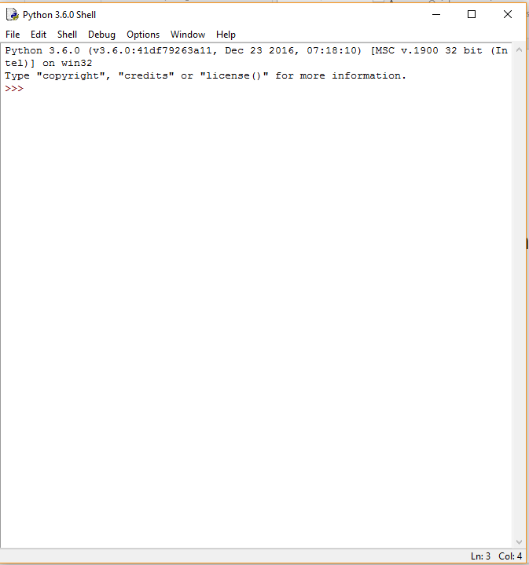
Installing Python3 on your Windows System

Slide 61
Python Scripting
In Python scripts, we write exactly the statements that we would have written in the interpreter.
We write Python scripts using vi as before.
vi test.py
We run a Python script using the following command in terminal:
python test.py

Slide 62
Operators
unary, binary or ternary
Arithmetic Operators
Relational Operators
Assignment Operators
Bitwise Operators
Logical Operators

Slide 63
Operator Precedence
The Higher the Position, the Higher the Precedence
**
~ + (unary) – (unary)
* / % //
+ -
&
^ |
<= >= < >
<> == !=
= %= /= //= -= += *= **=
not and or

Slide 64
Array vs. List in Python
List: A list in Python is a collection of items which can contain elements of multiple data types, which may be either numeric, character logical values, etc.
sample_list = [1,"Yash",['a','e']]
print(sample_list)
Array: An array is a vector containing homogeneous elements i.e. belonging to the same data type. Elements are allocated with contiguous memory locations allowing easy modification, that is, addition, deletion, accessing of elements.
import array
sample_array = array.array('i', [1, 2, 3])
# accessing elements of array
for i in sample_array:
print(i)

Slide 65
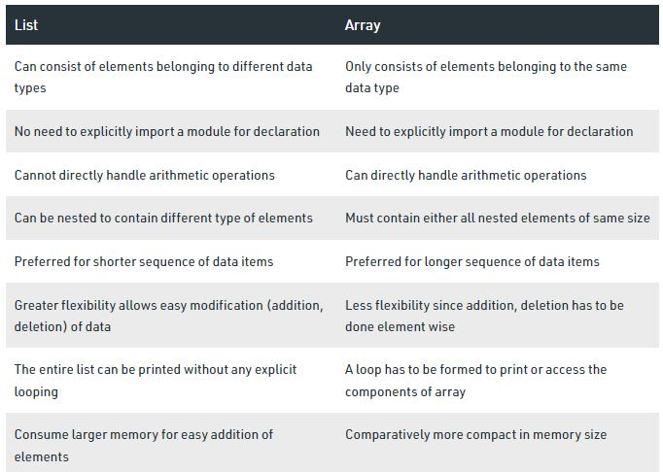
Array vs. List in Python

Slide 66
Array or List in Python
Initializing a list,
>>> a = []
>>> b = [1,2,3]
>>> c = [1,2.5,”a”,”cap”]
Printing
>>> print (b) will print [1,2,3]

Slide 67
Array or List in Python
Adding or Removing a single item,
>>> a = []
>>> a.append(2) # will add 2 to the list a
....
>>> a = [2,5,6,3,2]
>>> a.remove(2) # will remove the 1st 2

Slide 68
Array or List in Python
Adding a list of items to another list,
>>> a = [1,2,3]
>>> b = [10,11]
>>> a.extend(b)
>>> print (a) # will output [1,2,3,10,11]

Slide 69
Array or List in Python
Some common operations on lists,
>>> a = [5,2,3,6,1]
>>> len(a) # will return length of array
>>> a.sort() # will sort the array a
>>> a.reverse() # will reverse the array a
>>> a.count(x) # will return how many times x appears in a
>>> sum(a) # will return the sum of a

Slide 70
Strings
Strings are just (arrays of characters )
Example:
>>> s = “Rourkela”
>>> print (s[2]) # will print “u”
>>> print (len(s)) # will print 8
>>> s.append(‘A’) # will show error
>>> s = s + “A”
>>> print (s) # will print RourkelaA

Slide 71
Strings
Slicing is same as in lists
>>> s = “Rourkela”
>>> print (s[0:5]) # will print “Rourk”
>>> print (s[::-1]) #
Output = ??

Slide 72
Strings
Slicing is same as in lists
>>> s = “Rourkela”
>>> print (s[0:5]) # will print “Rourk”
>>> print (s[::-1]) # will print “alekruoR”

Slide 73
Strings
Removing a single character from a string
>>> s = “rourkela”
>>> print (s.index(‘u’)) # will print 2
>>> i = s.index(‘u’)
>>> s.replace(s[i], ‘’)
>>> print (s) #
Output?

Slide 74
Strings
Removing a single character from a string
>>> s = “rourkela”
>>> print (s.index(‘u’)) # will print 2
>>> i = s.index(‘u’)
>>> s.replace(s[i], ‘’)
>>> print (s) #
will print “rorkela”

Slide 75
Strings
Removing multiple occurrence of the same character from a string
>>> s = “rourkela”
>>> s.replace(‘r’, ‘’)
>>> print (s) # will print “oukela”

Slide 76
2D lists (multidimensional arrays)
Lists inside lists
>>> A = [ [1,2,3], [4,5,6], [7,8,9]]
>>> print (A[1][2])
>>> print (A[-1][-1])
>>> B = [“cat”, “dog”, “ball”]
>>> print (B[2][1])

Slide 77
2D lists (multidimensional arrays)
Lists inside lists
>>> A = [ [1,2,3], [4,5,6], [7,8,9]]
>>> print (A[1][2]) # will print 6
>>> print (A[-1][-1]) # will print 9
>>> B = [“cat”, “dog”, “ball”]
>>> print (B[2][1]) # will print ‘a’

Slide 78
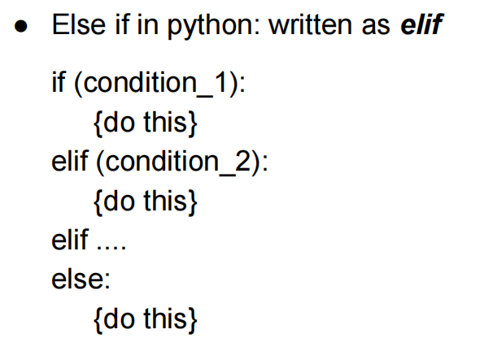
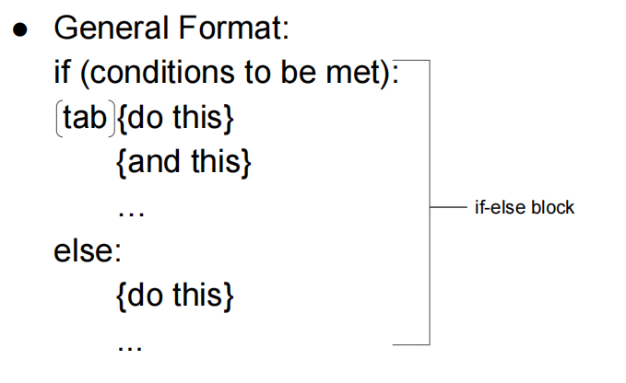
Conditional Statements

Slide 79
Conditional Statements
Example: check if a number is positive, negative or zero
num = 62
if (num<0):
print(“Number is negative”)
elif (num==0):
print(“Number is zero”)
else:
print(“Number is positive”)

Slide 80
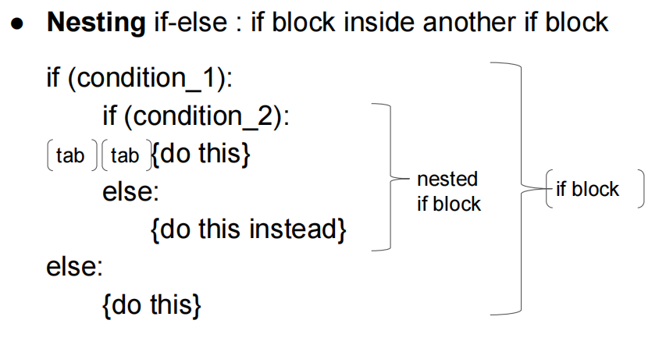
Complex Conditional Statements

Slide 81
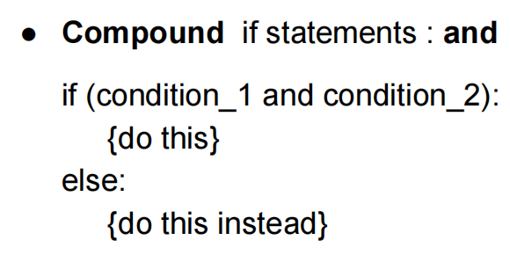
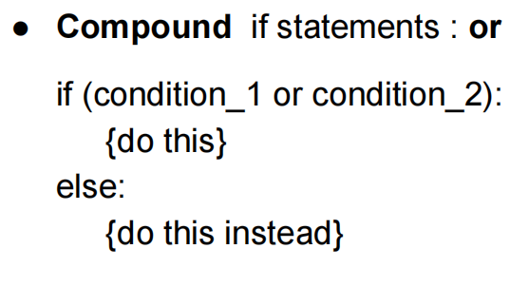
Complex Conditional Statements

Slide 82
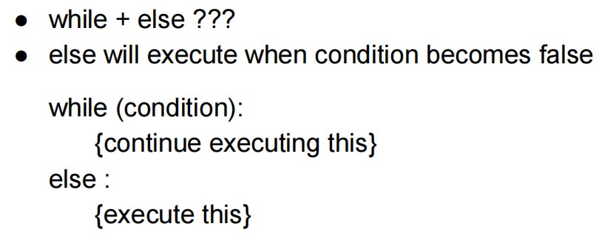
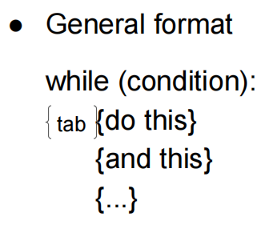
While Loop

Slide 83
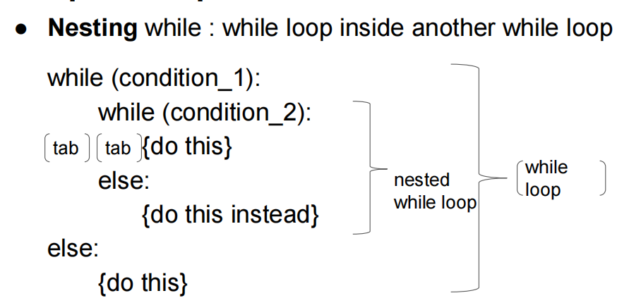
While Loop

Slide 84
While Loop
Example : sum of first 10 numbers

Slide 85
While Loop
Example : sum of first 10 numbers
num=1
sum=0
while (num <= 10):
sum = sum + num
num = num + 1
else :
print(sum)

Slide 86
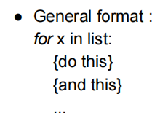
for Loop
Sum of elements in a list
???

Slide 87
for Loop
Sum of elements in a list
a = [1,5,2,3,7]
s = 0
for i in a:
s += i
print s

Slide 88
for Loop
for Loop and 2D List
a = [ [1,2] , [3,6], [6,9] ]
for i in a:
print i
a = [ [1,2] , [3,6], [6,9] ]
for i,j in a:
print i,j
What is difference??
for Loop and Strings
s = “Hello”
for i in s:
print i
Output ???

Slide 89
for Loop
for Loop and 2D List
a = [ [1,2] , [3,6], [6,9] ]
for i in a:
print i
Output: [1, 2] [3, 6] [6, 9]
a = [ [1,2] , [3,6], [6,9] ]
for i,j in a:
print i,j
Output: 1 2 3 6 6 9
for Loop and Strings
s = “Hello”
for i in s:
print i
Output : Print every character in newline

Slide 90
list comprehension
Square each element of a list,
a = [1,2,3,4,5]
[i**2 for i in a]
Check if elements are even or odd,
a = [2,3,6,5,1,4,8]
[i%2==0 for i in a]
>> print range(10) What will be output??

Slide 91
Dictionaries
● Objects with key-value pairs
● Contains a list of items where each item is a pair, i.e (key,value)
● Represented as ‘{}’
● Eg : D = {‘a’:5, ‘b’:6, ‘c’:7}
● Accessing items : D[‘a’] # will print 5
● No variables

Slide 92
Dictionaries
● D = {‘a’:2, ‘b’:3, ‘c’:5 }
● D.keys() # will print [‘a’, ‘b’, ‘c’]
● D.values() # will print [2,3,5]
● D.items() # will print [(‘a’,2), (‘b’,3),(‘c’,5)]
● dict( [ (1,2), (3,5) ]) # will return {1:2, 3:5}
● Why do I need a dictionary ?
● Practice problem : Reverse a dictionary

Slide 93
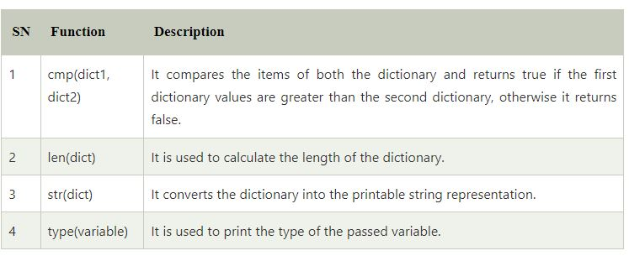
Built-in Dictionary Functions & Methods

Slide 94
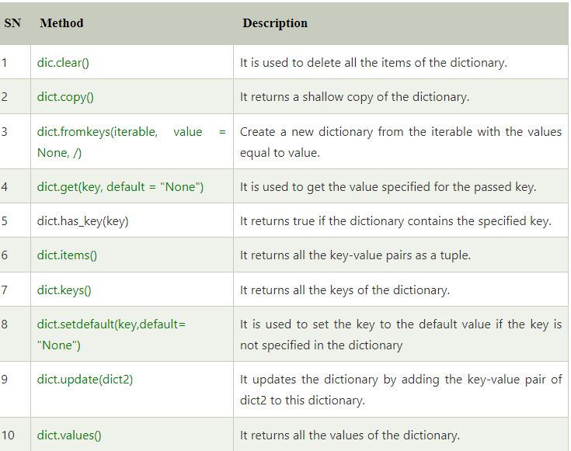
Dictionary Methods

Slide 95
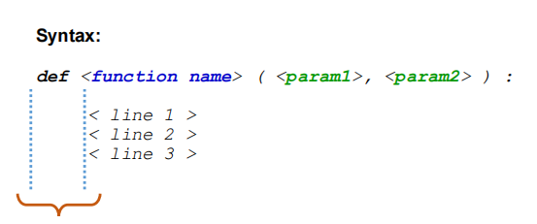
UDF

Slide 96
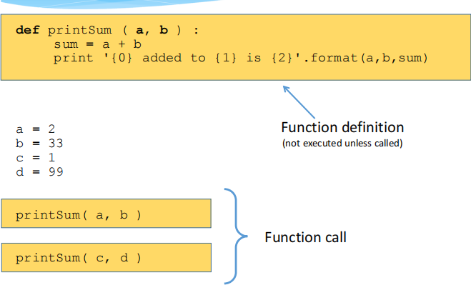
UDF

Slide 97
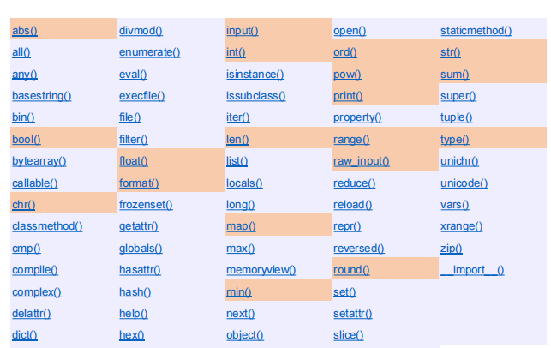
Standard Functions

Slide 98
Maths for Machine Learning

Slide 99
Maths for Machine Learning
Statistics
Probability
Metrics
Vectors
Linear Equation
Regression

Slide 100
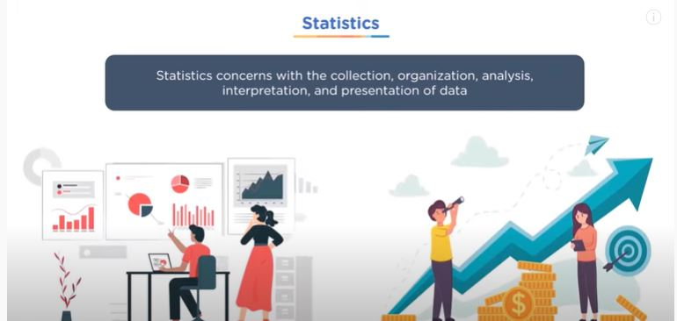
Statistics

Slide 101
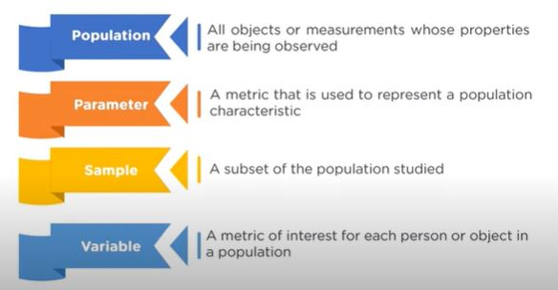
Important Terminology

Slide 102
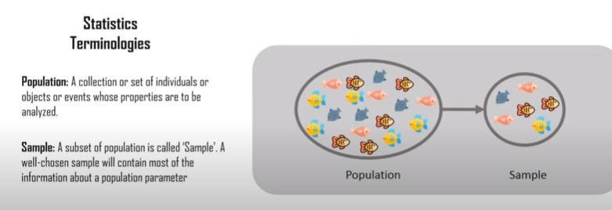
Important Terminology

Slide 103

Types of Sampling

Slide 104

Probabilistic Sampling

Slide 105

Types of Statistics

Slide 106

Types of Statistics

Slide 107
Types of Statistics
Descriptive Statistics
In the descriptive Statistics, the Data is described in a summarized way. The summarization is done from the sample of the population using different parameters like Mean or standard deviation. Descriptive Statistics are a way of using charts, graphs, and summary measures to organize, represent, and explain a set of Data.
Data is typically arranged and displayed in tables or graphs summarizing details such as histograms, pie charts, bars or scatter plots.
Descriptive Statistics are just descriptive and thus do not require normalization beyond the Data collected.

Slide 108

Types of Statistics

Slide 109
Types of Statistics
Inferential Statistics
In the Inferential Statistics, we try to interpret the Meaning of descriptive Statistics. After the Data has been collected, analyzed, and summarised we use Inferential Statistics to describe the Meaning of the collected Data.
Inferential Statistics use the probability principle to assess whether trends contained in the research sample can be generalized to the larger population from which the sample originally comes.
Inferential Statistics are intended to test hypotheses and investigate relationships between variables and can be used to make population predictions.
Inferential Statistics are used to draw conclusions and inferences, i.e., to make valid generalizations from samples.

Slide 110
Why Statistics in ML?
Statistics is a core component of data analytics and machine learning. It helps you analyze and visualize data to find unseen patterns.
Descriptive statistical methods are used to transform raw observations into information that you can understand and share.
Inferential statistical methods are used to reason from small samples of data to whole domains.

Slide 111

Descriptive Statistics

Slide 112

Descriptive Statistics

Slide 113

Descriptive Statistics : Measure

Slide 114

Descriptive Statistics : Measure

Slide 115

Descriptive Statistics : Measure

Slide 116

Descriptive Statistics : Measure

Slide 117

Descriptive Statistics : Measure

Slide 118

Descriptive Statistics : Measure

Slide 119

Descriptive Statistics : Measure

Slide 120

Measure of Spread

Slide 121

Measure of Spread

Slide 122

Measure of Spread

Slide 123

Measure of Spread

Slide 124

Example

Slide 125

Example

Slide 126

Example

Slide 127

Example

Slide 128

Example:

Slide 129

Statistics using Python

Slide 130

Example:

Slide 131

Inferential Statistics

Slide 132

Matrix

Slide 133

Matrix

Slide 134

Matrix

Slide 135


Matrix Multiplication : Different Size

Slide 136

Example

Slide 137

Example

Slide 138

Example

Slide 139

Example

Slide 140

Matrix

Slide 141

Example:

Slide 142


Slide 143

Linear Algebra

Slide 144

Linear Algebra

Slide 145

Linear Equation

Slide 146

Scalar

Slide 147

Vector

Slide 148

Vector : Machine Learning
A feature is a numerical or symbolic property of an aspect of an object. A feature vector is a vector containing multiple elements about an object. Putting feature vectors for objects together can make up a feature space.
The features may represent, as a whole, one mere pixel or an entire image. The granularity depends on what someone is trying to learn or represent about the object. You could describe a 3-dimensional shape with a feature vector indicating its height, width, depth, etc.

Slide 149

Vector : Machine Learning

Slide 150

Vector

Slide 151

Vector : Operation

Slide 152


Vector : Operation

Slide 153

Vector : Operation

Slide 154

Vector & Matrices

Slide 155

Vector & Matrices

Slide 156

Vector as Matrix : Solve Linear Equation

Slide 157

Vector as Matrix :Solve Linear Equation

Slide 158

Vector as Matrix :Solve Linear Equation

Slide 159

Vector as Matrix :Solve Linear Equation

Slide 160

Vector as Matrix :Solve Linear Equation

Slide 161

Example:

Slide 162

Example:

Slide 163


Example:

Slide 164


Example:

Slide 165


Slide 166

What is Probability?

Slide 167

Probability : Use Cases

Slide 168

Probability : Use Cases

Slide 169

Probability : Use Cases

Slide 170

Probability Terminology

Slide 171

Probability Terminology

Slide 172


Probability Terminology

Slide 173

Probability Terminology

Slide 174

Probability : Example
What is the probability that adding outcomes of both the dices will be SIX??

Slide 175

Probability : Example

Slide 176

Types of Probability

Slide 177

Types of Probability

Slide 178

Marginal Probability

Slide 179

Joint Probability

Slide 180
Joint Probability

Slide 181
Example :
What is the joint probability of rolling the number five twice in a fair six-sided dice?

Slide 182

Example :
What is the joint probability of rolling the number five twice in a fair six-sided dice?

Slide 183
Example :
What is the probability of getting a head followed by a tail in a coin toss?

Slide 184

Example :
What is the joint probability of getting a head followed by a tail in a coin toss?

Slide 185
Example :
What is the joint probability of drawing a number ten card that is black?

Slide 186

Example :
What is the joint probability of drawing a number ten card that is black?

Slide 187

Conditional Probability

Slide 188

Conditional Probability

Slide 189
Example:
In a group of 100 sports car buyers, 40 bought alarm systems, 30 purchased bucket seats, and 20 purchased an alarm system and bucket seats. If a car buyer chosen at random bought an alarm system, what is the probability they also bought bucket seats?

Slide 190

Example:
In a group of 100 sports car buyers, 40 bought alarm systems, 30 purchased bucket seats, and 20 purchased an alarm system and bucket seats. If a car buyer chosen at random bought an alarm system, what is the probability they also bought bucket seats?
P(B|A) = P(A∩B) / P(A) = 0.2 / 0.4 = 0.5.

Slide 191
Example:
Suppose you draw two cards from a deck and you win if you get a jack followed by an ace (without replacement). What is the probability of winning, given we know that you got a jack in the first turn?
Let event A be getting a jack in the first turn
Let event B be getting an ace in the second turn.

Slide 192

Example:

Slide 193
Example:
Suppose you have a jar containing 6 marbles – 3 black and 3 white. What is the probability of getting a black given the first one was black too.
P (A) = getting a black marble in the first turn
P (B) = getting a black marble in the second turn

Slide 194

Example:

Slide 195

Example:

Slide 196
Example:
Ans is: 0.024

Slide 197

Example:

Slide 198

Example:

Slide 199

Conditional Probability : Baye’s Theorem

Slide 200

Example:

Slide 201
Example:
What is the probability of drawing 2 King from a deck?

Slide 202

Example:
What is the probability of drawing 2 King from a deck?

Slide 203
End of Unit I.....

Slide 204
Project Ideas
Automation + Intelligence
Application ORIENTED
Cyber Sec. & Digital Foren

Slide 205
Project Ideas
Generating Textures and Patterns
Healthcare: predict stroke risk using a prediction model and provide personalized warning message
Handwriting Matching
Labeling of Audio File
Online Exam Invigilation
Game related to cyber Security
Accident Prediction
Chatboat for Univ.
AI/Ml for Dark web
Anomaly Detection
Phishing detection –WhatsApp
Behaviour Modelling System
Fake news detection

